Slide 1

Decoding the Language of Hands –
Machine Learning in Sign Language
Project Associates | Project Guide
20P31A1238 Nekkanti Divya Sri | Mrs. P. LATHA, M.Tech., Asst. Prof
20P31A1218 Imminni Saritha
20P31A1217 Gurram Madhu Nadh
20P31A1255 Siripurapu Krishna Vamsi
Department of Information Technology
Aditya College of Engineering & Technology (A)

Slide 2
Abstract
This project introduces a comprehensive solution to overcome communication barriers faced by deaf and mute people, particularly in emergency situations, by employing a vision-based technique for hand gesture recognition.
Utilizing the libraries for real-time hand gesture tracking, powered by YOLO(You Only Look Once), the system ensures accurate identification and classification of sign language gestures.
This vision-based approach enhances adaptability and responsiveness, allowing mute individuals to convey messages effectively.
The subsequent integration of voice conversion technologies, including Text-to-Speech (TTS) system, translates the recognized gestures into human-hearable voice, facilitating communication with individuals not proficient in sign language.
Decoding the Language of Hands – Machine Learning in Sign Language

Slide 3
Introduction
Sign-language has become a most common method of communicating to those people who cannot speak.
It is a language that uses the hand motions to express words. Sign language is a visual means of communication that primarily uses hand gestures, facial expressions, and body movements to convey meaning.
It is used by deaf and hard-of-hearing individuals as well as by people with hearing abilities who wish to communicate with them.
Decoding the Language of Hands – Machine Learning in Sign Language

Slide 4
Literature Survey
Sign Language Translator Using YOLO Algorithm:
The framework in the current paper utilizes Convolutional Neural Network (CNN) and You Only Look Once (YOLO) algorithm for real-time American Sign Language perception. Previous works include a framework for Indian Sign Language translation using gesture recognition algorithms and a CNN strategy for recognizing hand signals. Communication challenges between hearing and hearing-impaired individuals have been highlighted, emphasizing the importance of sign language knowledge. The use of CNN and YOLO algorithm is aimed at improving communication efficiency and accuracy in sign language translation.
A Review of the Hand Gesture Recognition System:
The reviewed articles focused on data acquisition, data environment, and hand gesture representation in the vision-based hand gesture recognition system. The research aimed to identify the progress and future directions of the vision-based hand gesture recognition system. Exclusion criteria were applied to select relevant studies focusing explicitly on vision-based hand gesture recognition in sign language. The conclusion emphasized the importance of addressing issues in data acquisition, features, and training data environment for real-life application readiness. Most articles highlighted issues and progress related to data acquisition in the vision-based hand gesture recognition system.
Decoding the Language of Hands – Machine Learning in Sign Language

Slide 5
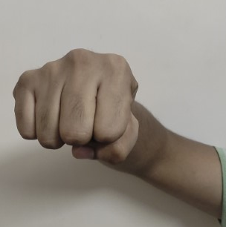
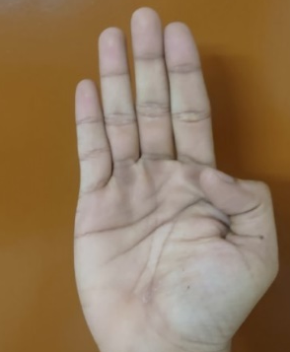
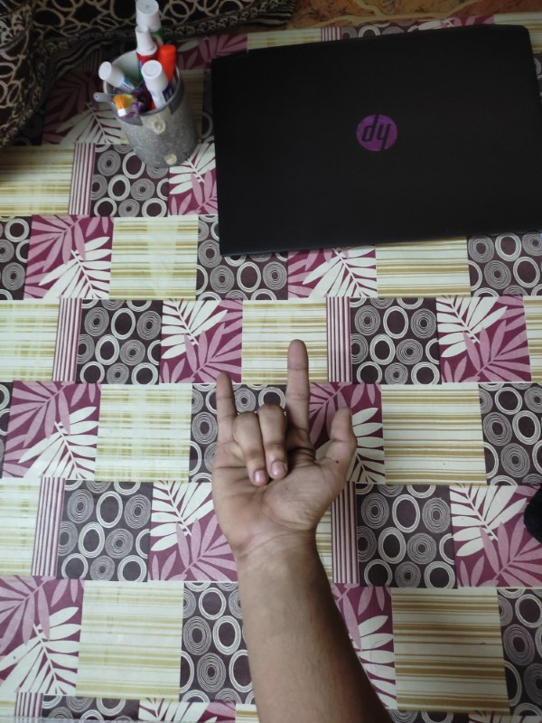
Dataset
Image of a Sign | Sign Number | Co-ordinates (X) | Co-ordinates (Y) | Height of an Image | Width of an Image
Yes | 1 | 0.554375 | 0.536667 | 0.306250 | 0.376667
Hello | 2 | 0.548125 | 0.371667 | 0.636250 | 0.506667
I Love You | 3 | 0.608750 | 0.490000 | 0.335000 | 0.363333
Decoding the Language of Hands – Machine Learning in Sign Language

Slide 6
Existing System
The existing systems that utilize electromechanical devices, particularly glove-based approaches, for extracting hand configuration and position information face several drawbacks. These systems often involve the use of specialized gloves equipped with sensors or other electromechanical components to precisely capture hand movements.
Disadvantages:
However, these devices tend to be expensive, limiting their accessibility to a broader user base. The cost factor becomes a significant barrier for widespread adoption, especially in scenarios where affordability is crucial, such as healthcare or assistive technology for individuals with disabilities.
Decoding the Language of Hands – Machine Learning in Sign Language

Slide 7
Proposed System
The proposed system introduces an innovative approach to overcome the challenges posed by existing electromechanical devices in hand gesture recognition. Instead of relying on expensive and user-unfriendly glove-based methods, the system employs advanced computer vision techniques, Python Imaging Library (PIL) which also known as Pillow and YOLO(You Only Look Once) object detection algorithm, to track and interpret hand gestures in real-time.
The interface ensures a natural and intuitive experience, allowing users to convey messages and it is deployed it in a desktop application using Tkinter, a GUI toolkit in Python. Additionally, the system integrates voice conversion technologies to facilitate communication for mute individuals.
Decoding the Language of Hands – Machine Learning in Sign Language

Slide 8
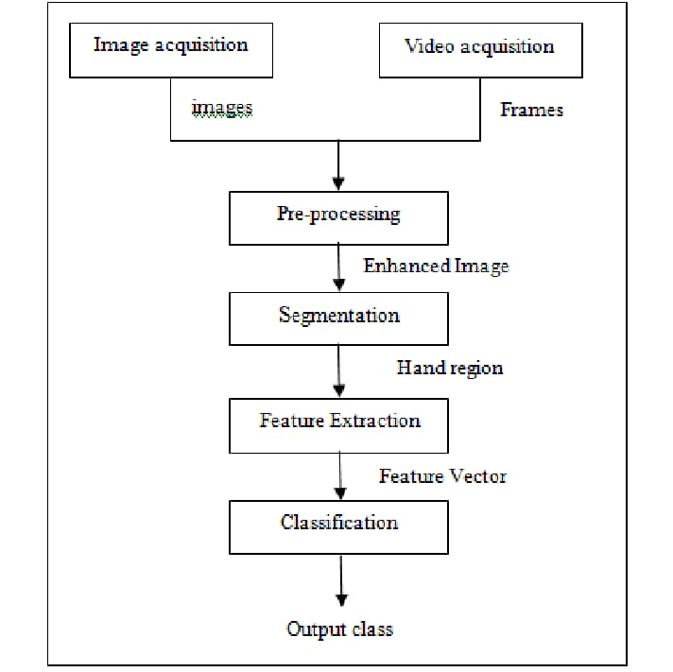
Architecture
Image Acquisition
Video Acquisition
Images
Frames
Pre-Processing
Enhanced Image
Segmentation
Hand Region
Feature Extraction
Feature Vector
Classification
Output
Decoding the Language of Hands – Machine Learning in Sign Language

Slide 9
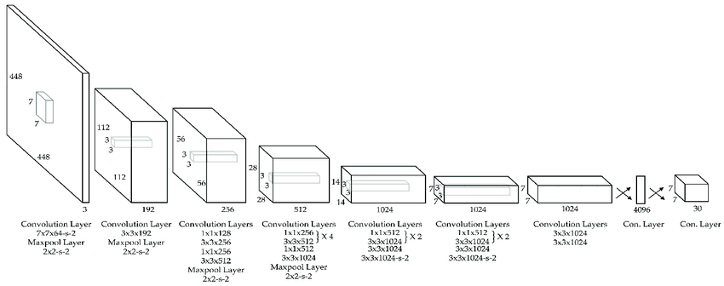
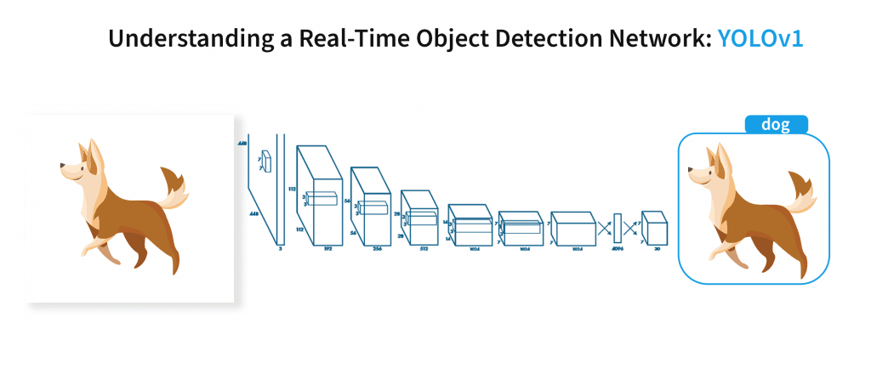
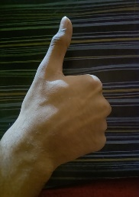
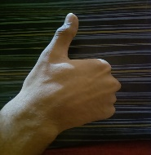
YOLO Architecture :
good
Decoding the Language of Hands – Machine Learning in Sign Language

Slide 10
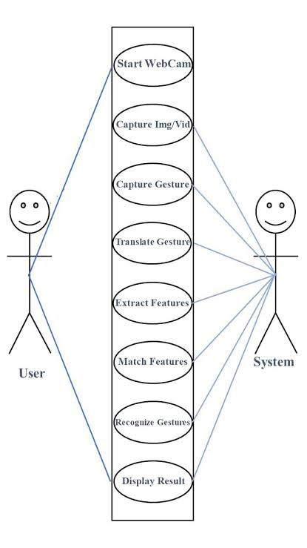
UML Diagram
Decoding the Language of Hands – Machine Learning in Sign Language

Slide 11
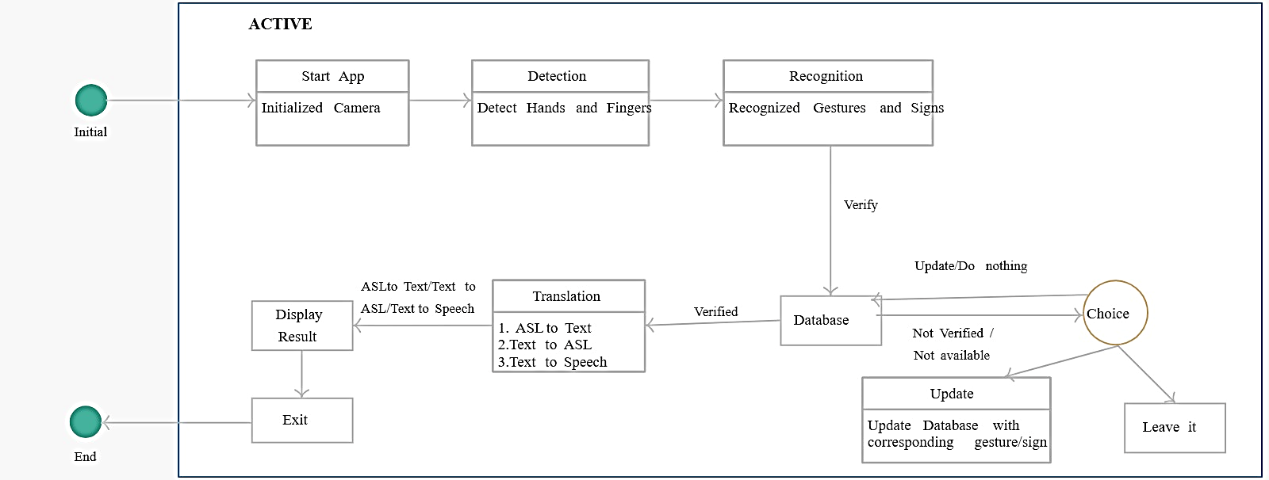
Active Case Diagram:
SL to Text /
Text to Speech
1. SL to Text
2. Text to Speech
Dataset
Update Dataset with corresponding gesture/sign
Decoding the Language of Hands – Machine Learning in Sign Language

Slide 12
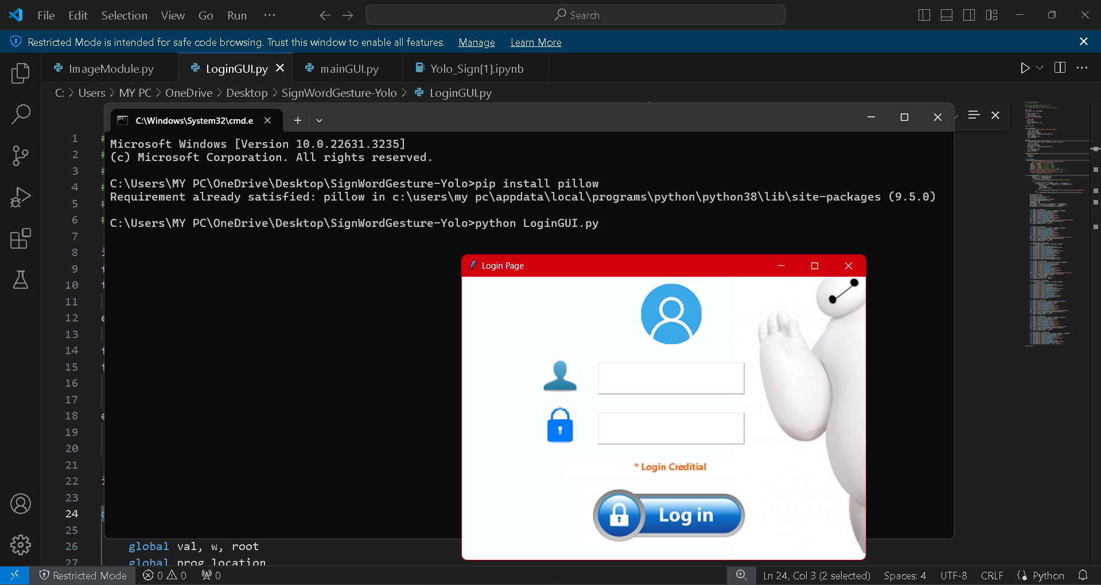
Result of Project
Decoding the Language of Hands – Machine Learning in Sign Language

Slide 13
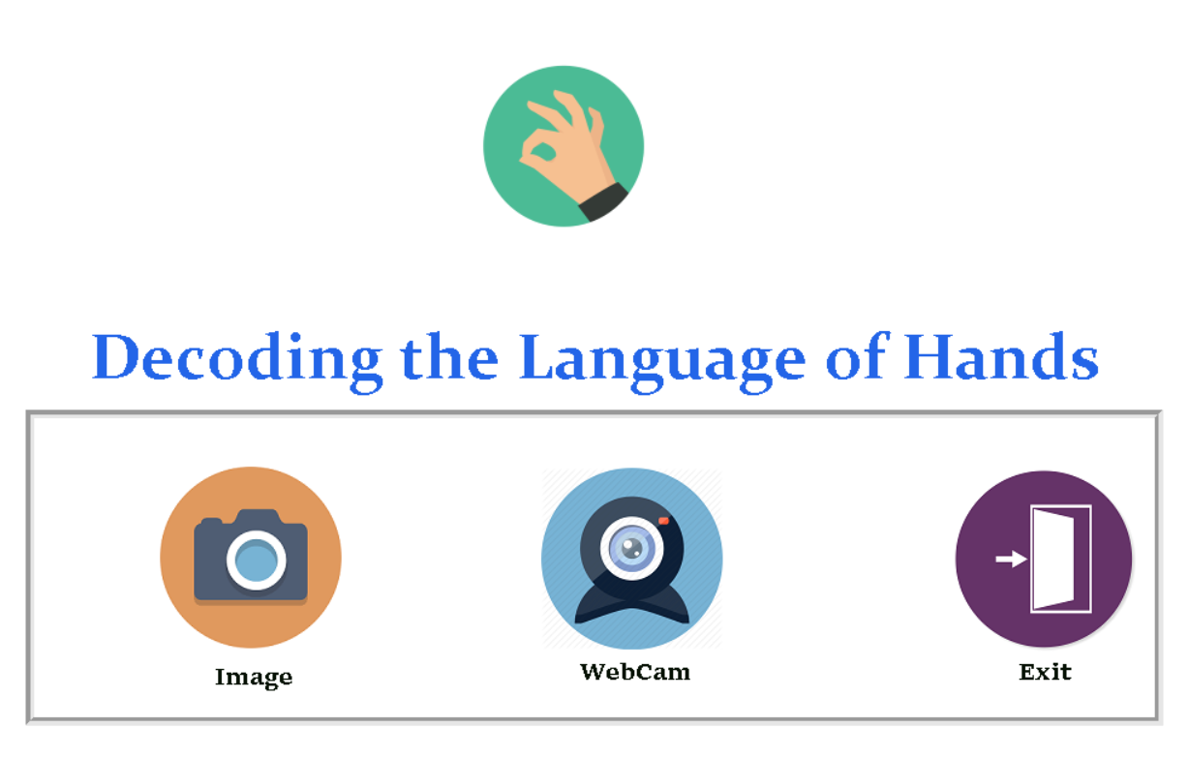
Decoding the Language of Hands – Machine Learning in Sign Language

Slide 14
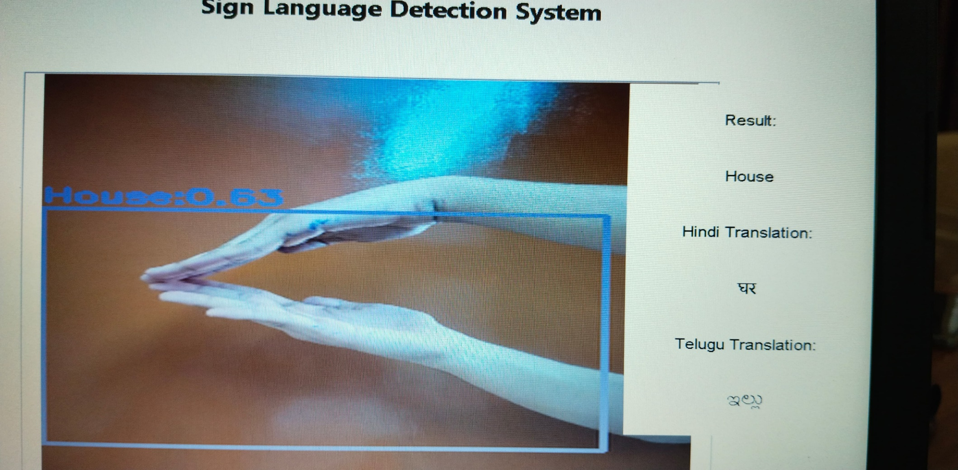
Output for Image Module
House
Decoding the Language of Hands – Machine Learning in Sign Language

Slide 15
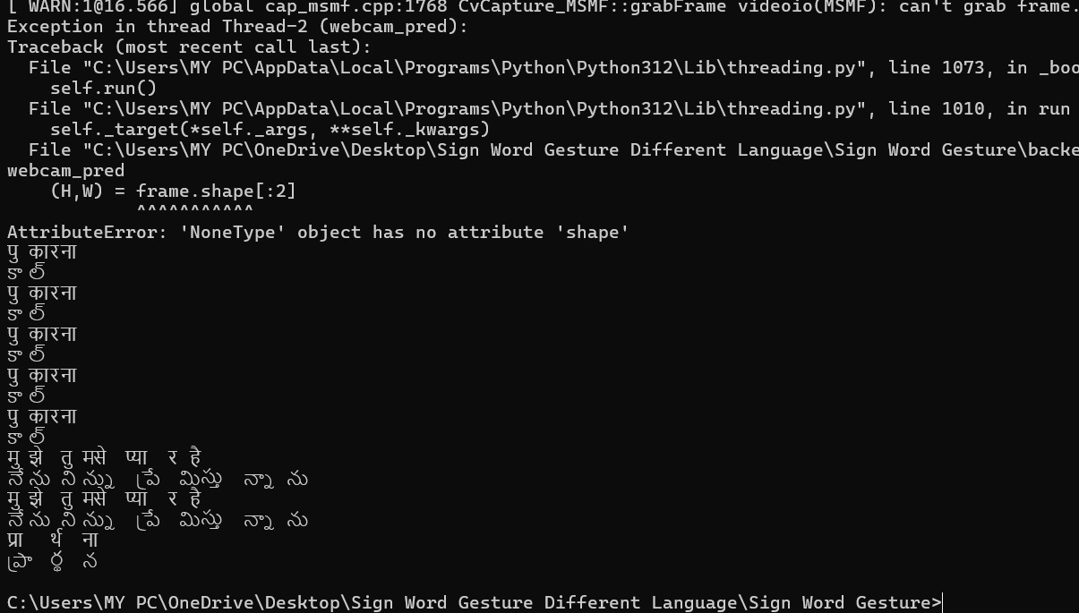
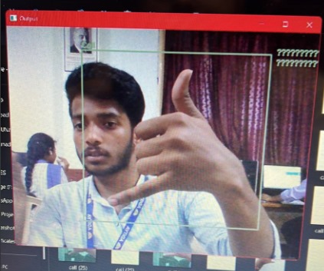
Webcam Access
Call
Decoding the Language of Hands – Machine Learning in Sign Language

Slide 16
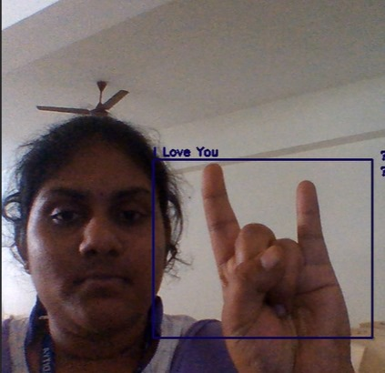
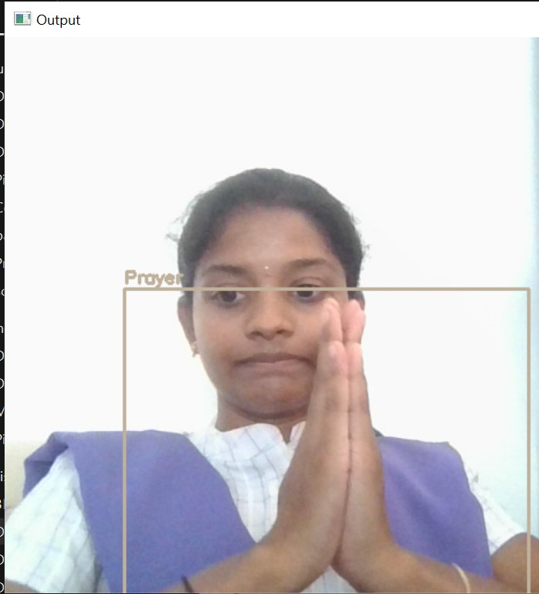
Output
I Love You
Prayer
Decoding the Language of Hands – Machine Learning in Sign Language

Slide 17
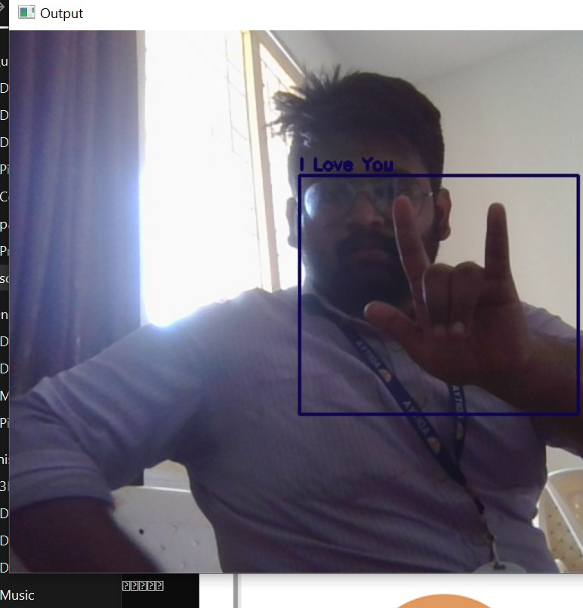
Output
I Love You
Decoding the Language of Hands – Machine Learning in Sign Language

Slide 18
Advantages of this project
Improved Emergency Communication: Enables deaf and mute individuals to effectively communicate in emergency situations, ensuring they can seek help or convey important information promptly.
Real-time Gesture Recognition: Utilizes YOLO-powered libraries for accurate and fast hand gesture tracking, enhancing the system's responsiveness and reliability in recognizing sign language gestures.
Enhanced Adaptability: The vision-based approach allows for flexibility in recognizing various sign language gestures, catering to different users' styles and dialects.
Inclusive Communication: Bridges the communication gap between mute individuals and those who are not proficient in sign language by converting recognized gestures into human-hearable voice using Text-to-Speech (TTS) technology.
Decoding the Language of Hands – Machine Learning in Sign Language

Slide 19
Advantages of this project
5. Visual Communication: Leverages the visual nature of sign language, which relies on hand motions, facial expressions, and body movements, making it accessible to both deaf and hard-of-hearing individuals, as well as those with hearing abilities who wish to communicate with them.
6. Accessibility: Provides a means for individuals with communication barriers to participate more fully in various aspects of life, including education, work, and social interactions, by offering a reliable and efficient communication method.
Decoding the Language of Hands – Machine Learning in Sign Language

Slide 20
Applications
Emergency Response Systems : In emergency situations such as fires, natural disasters, or medical emergencies, the project can enable deaf and mute individuals to communicate with emergency responders, conveying critical information about their safety or medical needs.
Healthcare Facilities : Within healthcare settings, the project can facilitate communication between healthcare providers and patients who are deaf or mute, ensuring accurate exchange of medical information, symptoms, and concerns.
Education Institutions : In schools and universities, the project can assist deaf and mute students in communicating with teachers, peers, and staff, enhancing their participation in classroom discussions, group projects, and extracurricular activities.
Customer Service : Businesses and organizations can implement the project to improve accessibility for deaf and mute customers, enabling them to communicate with customer service representatives through sign language gestures, both in person and remotely.
Decoding the Language of Hands – Machine Learning in Sign Language

Slide 21
Applications
6. Public Transportation : In transportation hubs such as airports, train stations, and bus terminals, the project can facilitate communication between deaf and mute travelers and transportation staff, ensuring smooth navigation, assistance, and accommodation.
7. Social Interactions : The project can be used in various social settings, such as gatherings, events, and community centers, allowing deaf and mute individuals to engage in conversations, make requests, and express themselves effectively through sign language gestures converted to audible speech.
8. Remote Communication : With advancements in technology, the project can also be implemented in digital platforms and communication tools, enabling deaf and mute individuals to communicate with friends, family, colleagues, and service providers remotely, bridging the gap between sign language and spoken language users.
Decoding the Language of Hands – Machine Learning in Sign Language

Slide 22
Conclusion
In conclusion, the project "Decoding the language of Hands – Machine Learning in Sign Language", tackles the
challenge of communication barriers between sign language users and others. It achieves this by developing a real-time
sign language recognition system powered by the robust YOLOv3 object detection architecture. The user interface prioritizes ease-of-use, offering options for uploading images or utilizing the live webcam for sign recognition. The system doesn’t require language selection – it automatically displays the recognized sign's label, recognition accuracy, and translates it into three languages: English, Hindi, and Telugu. This on-screen display caters to users familiar with any of these languages. Additionally, for those unfamiliar with sign language, the system offers human-hearable voice output in English, effectively translating the gesture into spoken English. Error messages are incorporated to handle situations with poor image quality or unrecognizable signs, ensuring a smooth user experience. Overall, this project demonstrates the immense potential of machine learning to bridge communication gaps and promote inclusivity for sign language users.
Decoding the Language of Hands – Machine Learning in Sign Language

Slide 23
Futurescope
There are some potential futurescopes for further improvement and expansion, including :
By incorporating a larger and more diverse dataset encompassing various signing styles and regional variations, the model's accuracy in recognizing complex two- handed signs can be significantly improved. This will ensure the system can handle the nuances of sign language communication effectively.
Future iterations could explore integrating contextual awareness. This would allow the system to consider the sequence of signs, facial expressions, and body language to understand the broader meaning being conveyed in sign language conversations. The project could be extended to identify the signer. This could be particularly beneficial in situations where multiple signers are present, allowing for personalized interactions.
Explore integrating with advanced translation services that offer sign language- specific translation models. This would provide more accurate and nuanced translations, further bridging the communication gap between sign language and spoken languages. By pursuing these possibilities, this project has the potential to become a groundbreaking tool for seamless communication within the deaf and hard-of-hearing community, fostering inclusivity and empowering sign language users to connect and interact more effectively.
Decoding the Language of Hands – Machine Learning in Sign Language

Slide 24
THANK YOU
Decoding the Language of Hands – Machine Learning in Sign Language

